Slide 1
Online Shopping

Slide 2
Search
Login/Register
HOME | Products | Cart | Contact | View Basket
Product Image
Product Name
Product Price
Product Image
Product Name
Product Price
Product Image
Product Name
Product Price
Product Image
Product Name
Product Price
1|2|3|4|5

Slide 3
Login
Email
Registration
Password
ADMIN
User Type
HOME
USER

Slide 4
Search
Login/Registar
Category | Sub-Category | Product | Size | Service | Report
Insert | Insert | Insert | Insert | Insert
Update | Update | Update | Update | Update
Delete | Delete | Delete | Delete | Delete

Slide 5
Insert Category
Category Name
HOME
Reset
Insert

Slide 6
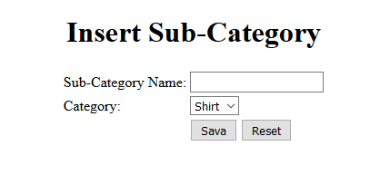
HOME

Slide 7
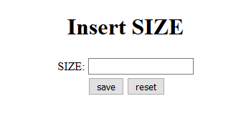
HOME

Slide 8
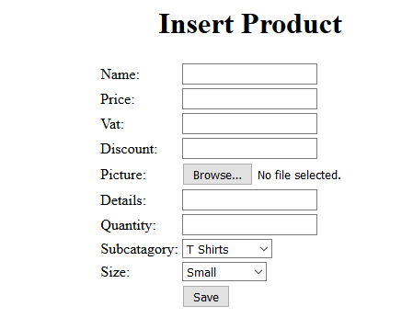
HOME

Slide 9
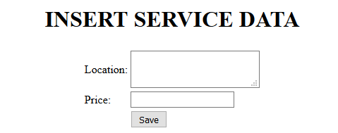
HOME

Slide 10
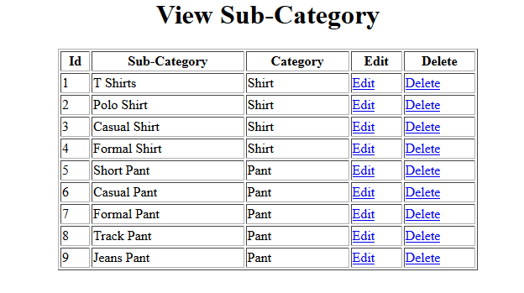
HOME

Slide 11
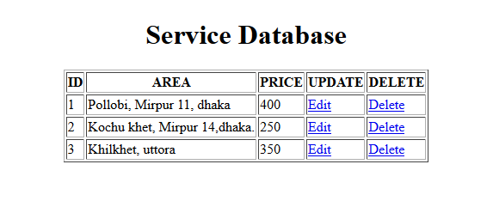
HOME

Slide 12
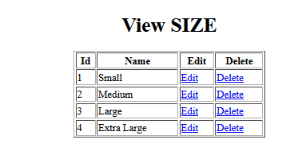
HOME

Slide 13
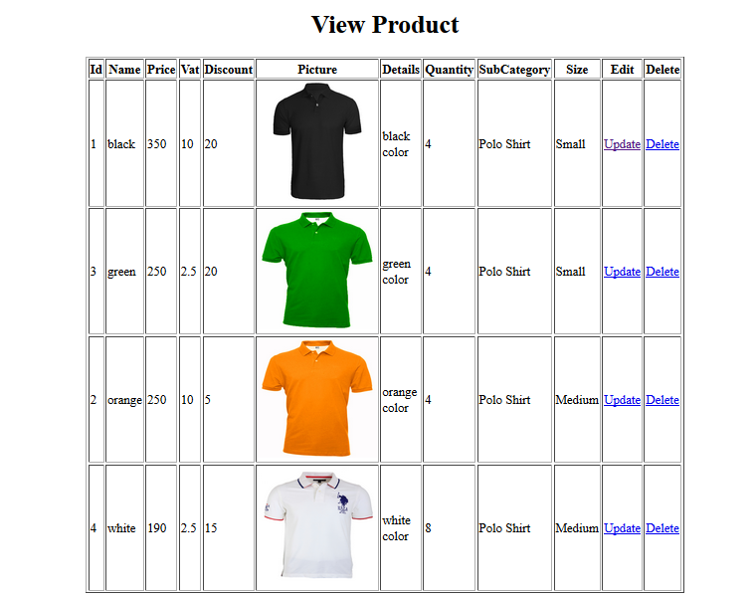
HOME

Slide 14
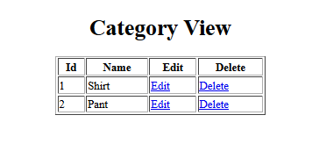
HOME

Slide 15
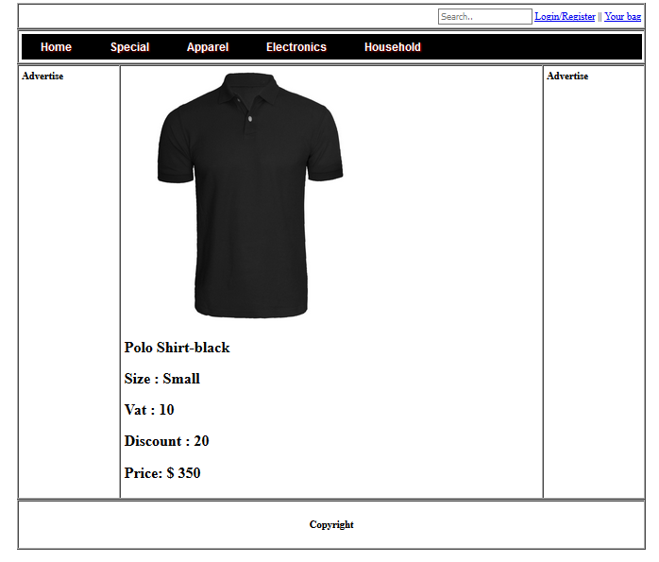
Add TO Cart
HOME
View Basket

Slide 16
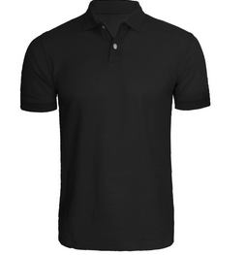
Search
Login/Registar
HOME | Products | Cart | Contact | View Basket
Product Id | Product Image | Product Name | Product Price | Quantity | Total Price | Action
1 |  | Polo Shirt | 350 |  | 290 | Remove
2 |  | Shirt | 1000 |  | 3050 | Remove
 |  |  |  |  | 3340
- | 1 | +
- | 3 | +
Place Order
Continue Shopping

Slide 17
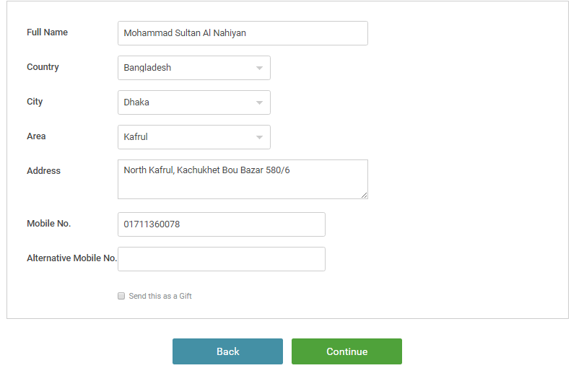
BACK
Confirm

Slide 18
Start Date
End Date
Product Name | Quantity | Price
POLO SHIRT | 3 | 300

Slide 19
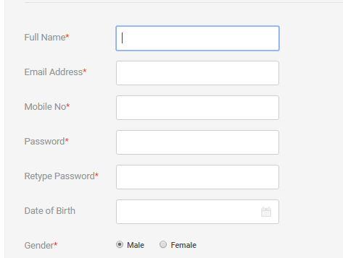
Sign Up
Back

Slide 20
Online Shopping Database Design
Category
C_id [P]
C_name
Sub-Category
SubC_id [P]
SuC_name
C_id [F]
Products
P_id [P]
P_name
P_price
P_vat
P_discount
P_picture
P_details
P_quantity
S_id [F]
SubC_id [F]
M:1
Size
S_id [P]
S_name
Service
Ser_id [P]
Ser_area
Ser_price
1:M
1:1
1:M
M:1
1:1
User
U_id [P]
U_name
U_email
U_contact
U_password
U_gender
U_type
1:M
Order
I_id [P]
quantity
P_id [F]
Pur_id [F]
M:1
1:M
Comment
P_id
U_id
Description
rating
M:M
M:1
M:M
Delivary
D_id [P]
D_address
D_date&time
D_name
Ser_id [F]
Purches
Pur_id [P]
Pur_date&time
U_id [F]
Total
M:M
M:M

